Slide 1
Session 2/3/4 END OF CHAPTER ASSESSMENT (Activity of Integration)
NCDC

Slide 2
Session Outcomes
By the end of this session, participants should be able to:
Appreciate why end of topic assessment is done.
Generate an end of chapter activity of integration.

Slide 3
Introduction
A competence based assessment approach focuses more on:
What the individual learner can do rather that what he/she knows.
The application of knowledge (what has been learnt) in a range of situations.
Recognising the achievements made by the learner however small they may be.

Slide 4
Activity 1. Understanding the Activity of Integration (10 minutes)
Brainstorm and share:
What you understand by the activity of integration
The purpose of the activity of integration
The similarities and differences between the activity of integration and the current School Based Summative Assessment

Slide 5
Activity of Integration
Competency
Activities
Tools
Support materials
Activity of Integration

Slide 6
What an Activity of Integration is
The last summative activity to evaluate the learner’s understanding (ability to solve a contextualized problem through integration of the knowledge, skills and behaviors) of the chapter.
Activities of Integration (AoIs) combined in a term/year will contribute to 20% of the National Summative Assessment.
Activity of integration done in a range of situations should enable the learner to demonstrate the competency stated in the Chapter introduction.
How do Formative Assessment activities link to the AoI?

Slide 7
Activity 2: Developing an Activity of integration(10 minutes)
In your groups;
Study the 3 documents (Syllabus, Learner’s book and TG),track the presentation of the topics in the documents and do the following:
How do the LOs contribute to the achievement of the competency?
How can you use the Los to develop a scenario?
Develop a scenario which can bring out the Los.
What else do you think should be assessed from the given topic?

Slide 8
Translating knowledge to Performance ability levels
In life we have different abilities, hence, we perform and achieve at different levels.
Activity of integration sums up the topic; and learners are placed in different categories of performance/achievement.
For recording purposes, the levels of performance are categorized under : Basic, Moderate, and Accomplished.
These performance levels are a translation of pre-set performance standards with descriptors of:
Basic: Few LOs achieved but not sufficient for overall achievement =1
Moderate: Some LOs achieved, enough for overall achievement =2
Accomplished: Most/All Los achieved with ease =3
Note: The placement values of 1,2 and 3 are identifiers but NOT marks.

Slide 9
Activity 3: Studying Sample Activities of Integration (AoI) 10 mins
In your groups,
Explore the sample activity of integration given in the learner’s book to identify its features (whether it assesses most/all the LOs in the Topic) and share your findings.
Components of the activity of integration
Context/Problem/Scenario
Instruction/Expected output
Support/Resources/materials

Slide 10
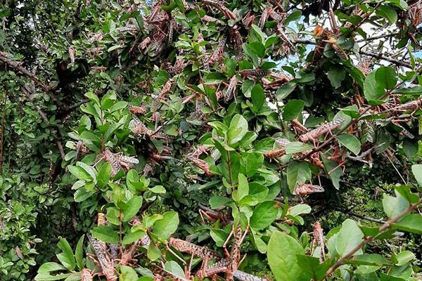
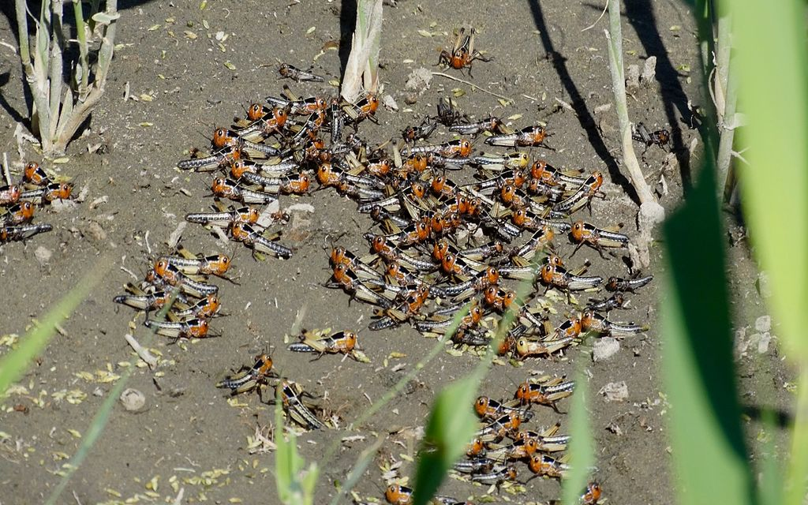
AoI Example explained Short-horned grass hoppers or desert locusts are moving in swarms across Eastern Africa. So far they have covered several kilometers south of Ethiopia and northwest of Kenya. These locusts eat all green plants found in their way. In the past few days, a swarm of locusts was sighted approaching Karamoja region.

Slide 11
.
Design a sensitization message for the Ministry
of Disaster preparedness on what is likely to
happen if the locusts invaded the rest of Uganda.

Slide 12

Activity of Integration: Developing a sensitisation message
Context/Problem/scenario
Short-horned grass hoppers or desert locusts are moving in swarms across Eastern Africa. So far they have covered several kilometers south of Ethiopia and northwest of Kenya. These locusts eat all green plants found in their way. In the past few days, a swarm of locusts was sighted approaching Karamoja region.
Task: Design a sensitization message for the Ministry
of Disaster preparedness on what is likely to
happen if the locusts invaded the rest of Uganda.
Disaster
Disaster risk management
Instruction/Expected output
Abilities/Resources

Slide 13
Support/ Stimulus materials

Slide 14
2. Compare the activity of integration with the sample Activity of Integration: Word processing a letter presented below to check its appropriateness
Activity of Integration: Word processing a letter
Context/Problem
Your class is planning an end of year party at the end of the term scheduled for 21st November this year. It will take place in the main hall starting at 8:30am.
Word process and print a letter inviting the head teacher and members of staff to the party.
Instruction/Expected output
Support: Equipment, pictures,

Slide 15
Context/Problem/Scenario explained
Find the LCM of 3 & 4

Slide 16
Context/Problem/Scenario explained…
Musa’s family gets meals every 3 hours. Joan’s family gets meals every 4 hours.
On some day, the two families got meals at the same time, at 8am.
When did they get meals at the same time again?
Which family had got more meals and why?

Slide 17
Activity 4:Developing an Activity of Integration (30 mins)
In your groups, study any chosen topic from the syllabus and develop an activity of integration to assess the competency of the learner.
2. Present your work to the plenary.

Slide 18
.
Who develops the AoI?

Slide 19
Session summary
Competence –based assessment strives for Higher Order thinking skills (HOTs) for purposes of making use of the learnt knowledge and evaluating the application of knowledge in new scenarios/situations.
One competency can apply in more than one topic and levels but there is need to stretch performance to the most high level.
A topic can have one or more AoIs
Competency-based assessment provides detailed information about the learner and builds his/her confidence when mastering a skill and learn to identify what is next.
An ACTIVITY OF INTEGRATION is one of the assessment approaches which enables learners to display their COMPETENCY
END

Slide 20

.

Slide 21
Session 5: The Evaluation Grid

Slide 22
Session Outcomes
By the end of this session, participants should be able to:
Understand the features of an evaluation grid
Construct an evaluation grid based on a chapter of a particular subject.

Slide 23
Features of an evaluation grid
Activity one: (3mins)
In groups,
Brainstorm and list the key components of an evaluation grid
Explain what each of the components entails
Share your findings

Slide 24
Features of an evaluation grid…
Topic competency: the learner uses a word processing software to create, edit and print documents
Activity of Integration: Word processing a letter
Your class is planning an end of year party scheduled for 21st November this year. It will take place in the main hall starting at 8:30 am.
Word process a letter inviting the head teacher and members of staff to the party.

Slide 25
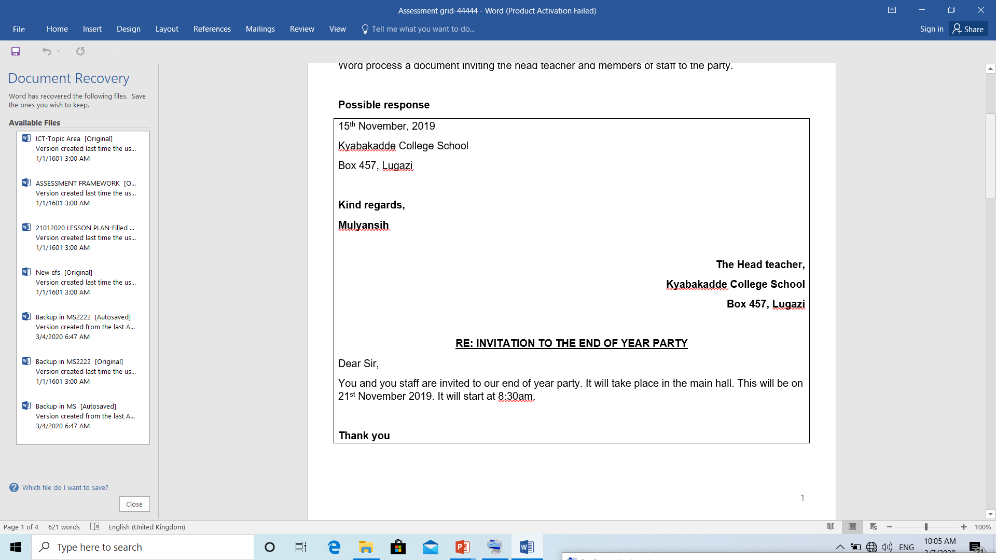
Activity: Score the written letter

Slide 26
Evaluating an Out put
Activity two: (5mins)
In groups,
Using the AoI that you developed in session one,
Task:
State the output of the AoI
Develop the key concepts to be assessed in the output
Share your findings in plenary

Slide 27
Key message
It is important that for each Output there are clear concepts that will be considered for assessment.
This is what we call the “Basis for evaluation”

Slide 28
Translating knowledge to Performance ability levels
In life we have different abilities, hence, we perform and achieve at different levels.
Activity of integration sums up the topic; and learners are placed in different categories of performance/achievement.
For recording purposes, the levels of performance are categorized under : Basic, Moderate, and Accomplished.
These performance levels are a translation of pre-set performance standards with descriptors of:
Basic: Few LOs achieved but not sufficient for overall achievement =1
Moderate: Some LOs achieved, enough for overall achievement =2
Accomplished: Most/All Los achieved with ease =3
Note: The placement values of 1,2 and 3 are identifiers but NOT marks.

Slide 29
Features of an evaluation grid
Output
Basis for Evaluation
Relevance/3
Accuracy/3
Coherence/3
Excellence/1
Expected deliverable from the learner in line with the competency.
Key concepts to be assessed on the output. (Pillars/standards)
The quality or state of being closely connected or appropriate
The quality or state of being correct
The quality of being logical and consistent
The quality of being outstanding or extremely good
(this earns a score of 1)
For each, describe the learner’s achievement at the 3 levels

Slide 30
Matrix showing possibilities in an evaluation grid
Output | Basis of evaluation | Relevance | Accuracy | coherence | Excellence
oooooo | Basis x | /3 | /3 | /3 | /1
 | Basis y | /3 | /3 | /3
 | Basis z | /3 | /3 | /3
 | etc

Slide 31
Developing the Evaluation grid
Activity three: (20mins)
In your groups, using the Activity of Integration you developed in session one:
Refine the expected output and its basis of evaluation (refer to activity two)
For each basis of evaluation, Using the 3 levels of achievement describe the expected attainment of the learners for relevance, accuracy and coherence
Describe what is expected of a learner to attain the excellence score
Present your work in a matrix (evaluation grid) and share with plenary

Slide 32


Slide 33
Session Summary
The evaluation grid is key for end of topic assessment of the learners
It is important to have a basis of evaluation for the Outputs
The basis for evaluation can be one or more depending on the output expected
For each output there must be description of learners achievement at the 3 levels in terms of relevance, accuracy and coherence
For each AoI the outstanding learner is described once in the Excellence column
The description of learner’s achievement is based on the Evaluation grid

Slide 34
Session 3: Reporting Learner Achievement

Slide 35
Session Outcomes
By the end of this session, participants should be able to:
identify what to record about learner achievement and when to record it.
Compute learner’s assessment scores.
Interpret learner’s assessment records
Report learner achievement

Slide 36
Activity 1
Go to syllabus section on record keeping.
Read it.
Share with us what you have learn from the section.

Slide 37
What to record about learner achievement and when
In every topic, assess the AoI
AoI = Check point for measuring level of learner achievement in a chapter in line with the competency.
Guiding questions (refer to syllabus, LB)
Is it true that an AoI encompasses all LOs in a topic?
How many AoI does a chapter have?
How many AoI can be done in a term?
Do all AoI carry equal maximum scores?
When do we record learner achievement?
For what purpose are the achievement records?

Slide 38
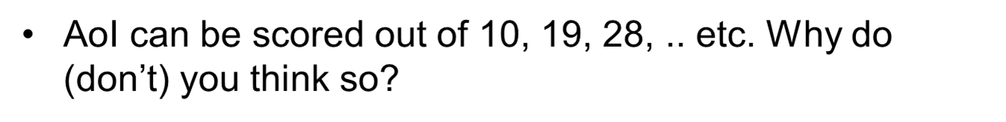
Computing learners’ assessment scores basing on identifiers
Output
Basis for Evaluation
Relevance/3
Accuracy/3
Coherence/3
Excellence/1
Expected deliverable from the learner in line with the competency
Key concepts to be assessed on the output.
The quality or state of being closely connected or appropriate
The quality or state of being correct or precise
The quality of being logical and consistent
The quality of being outstanding or extremely good

Slide 39
Matrix showing possibilities in an evaluation grid
Output | Basis of evaluation | Relevance | Accuracy | coherence | Excellence
oooooo | Basis a | /3 | /3 | /3 | /1
 | Basis b | /3 | /3 | /3
 | Basis c | /3 | /3 | /3
 | etc

Slide 40
Computing learner’s assessment scores basing on descriptors
AoI are scored out of 10, 19, 28, etc.
For 1 AoI, eg 20/28, scale down to a max of 3: (1-Basic, 2-Moderate, 3-Accomplished). 20/28*3=___
For topics with >(greater than)1 AoI, get totals and then scale down.
AoI 1: /10, AoI 2: /19 =====/29
Eg: Score AoI 1: 7/10, AoI 2: 13/29 =====20/29
Then scale down the scores to a maximum of /3 20/29*3=___, etc (1 dp).

Slide 41
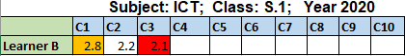
Recording Assessment Scores
Assuming Learner B has scores: C1: 18/19 (2.8), C2: 2.2, C3: 20/28 (2.1). Record accordingly as shown below.

Slide 42
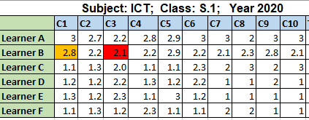
Recording Assessment Scores…
Record sheet for all learners.
What interpretation can you (teacher) make out of the learners’ data above?

Slide 43
Reporting achievement using descriptors When do we report and how?
End of term (report card)/year/parents day, etc.
Eg. Term ends at C4. Compute the scores?/ VD comes in at C2,…..
Compute average and put it to ranges below
Descriptor | Range | Identifier
Few competencies achieved | 0.9-1.4 | 1
Some competencies achieved | 1.5-2.4 | 2
Most or all competencies achieved | 2.5-3.0 | 3

Slide 44
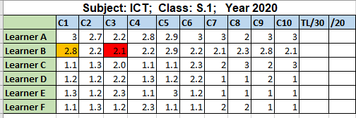
Generating 20%
Other contributors to 20%: Project work, etc etc
ICT will be used to deliver the record sheet to the assessment body.
Learner Identification Number (LIN) to be used.

Slide 45
Session Summary
Identified what to record about learner achievement and when to record it.
Computed learner’s assessment scores.
Interpreted learner’s assessment records
Reported learner achievement

Slide 46


Slide 47
Thank You

